Slide 1


https://bestelectronics4u-frontend.onrender.com/
BestElectronic4U: Smart E-Commerce Platform
Team 7 Presentation
By: Ahmed Hamouda, Olufemi Adeonigbagbe, Brandon Bedoya, Minning Liu, Cai Rong Li, Yulin Ding
Notes:
1

Slide 2
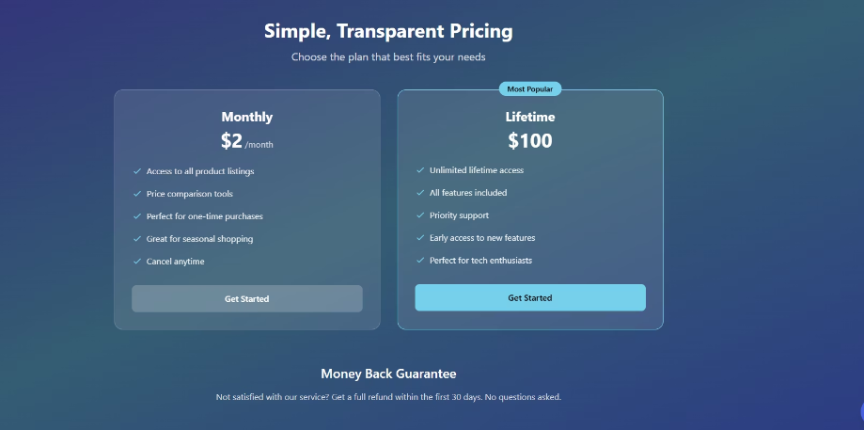
Business Idea Overview
BestElectronics4U is a dynamic comparison and marketplace platform for electronics shoppers. The website allow users to compare electronic products across different platforms— pricing, and reviews—to make smarter buying decisions. In addition to helping consumers find the best deals, BestElectronics4U also enables vendors to upload and manage their own products, offering a platform for showcasing their latest electronic deals.
Profit Model
Subscription plans to access the BestElectronics4U Marketplace, which includes monthly and lifelong subscriptions
Notes:
4

Slide 3







Tech Stack & Tools
Backend Technologies
Frontend Technologies
Deployment
Node.js | PostgreSQL
React.js | Tailwind CSS
Docker | Render | AWS
Notes:
5

Slide 4
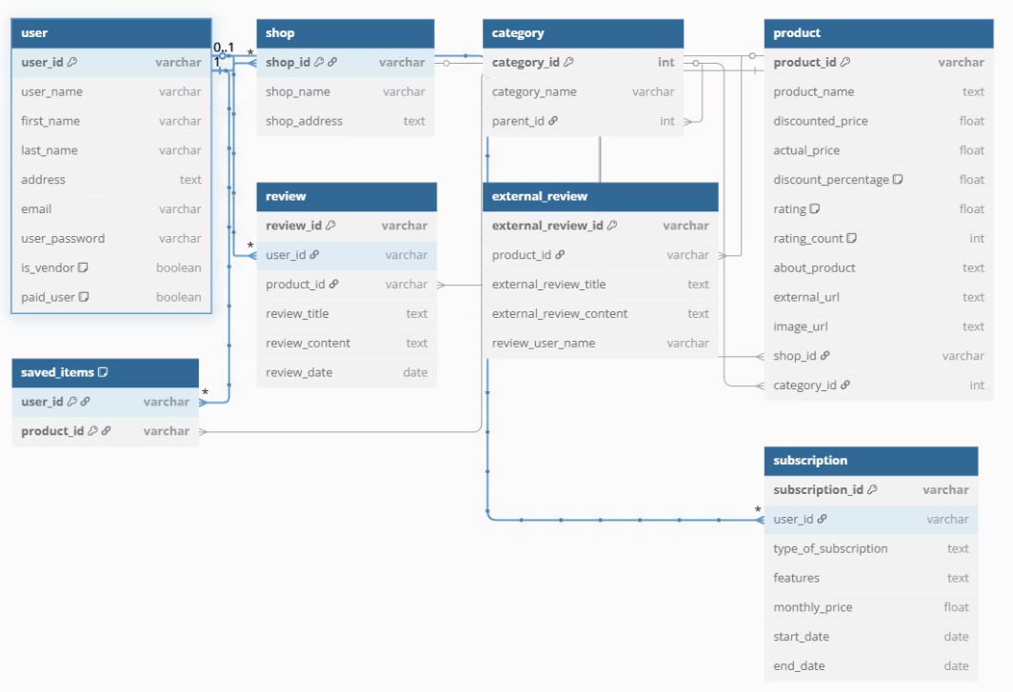
02 2NF Relational Model Diagram
Core Entities
Users
Orders
Services
Payments
Relationships
User → Orders (1:many)
Services ←→ Orders (many:many)
Notes:
6

Slide 5
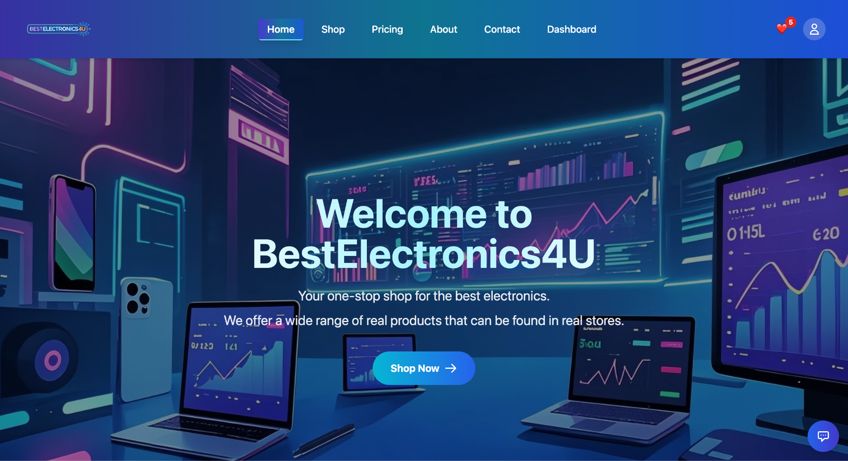
03 Landing Page Demo
Notes:
7

Slide 6
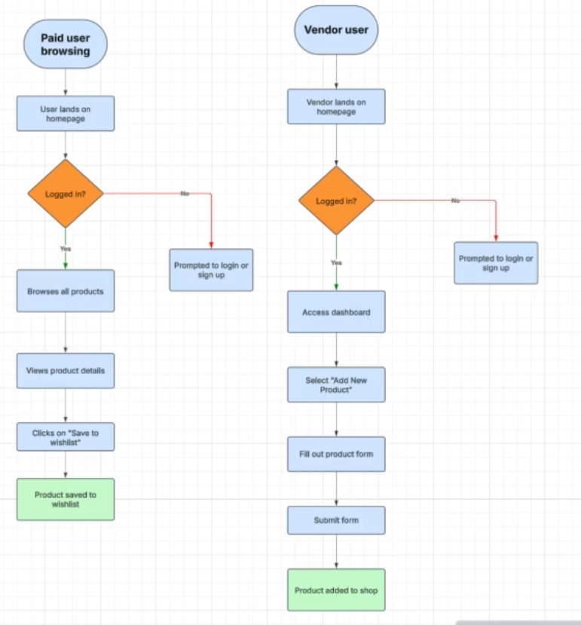
User Journey Diagram (Use Cases)
Notes:
9

Slide 7











05 Live Action Demo
User Registration
Streamlined sign-up process captures essential information while maintaining simplicity and security.
Purchase Flow
Users browse curated electronics, add items to cart, and complete checkout with personalized recommendations.
UX Elements
Real-time notifications, confirmation emails, and progress indicators keep users informed throughout their journey
Notes:
10

Slide 8
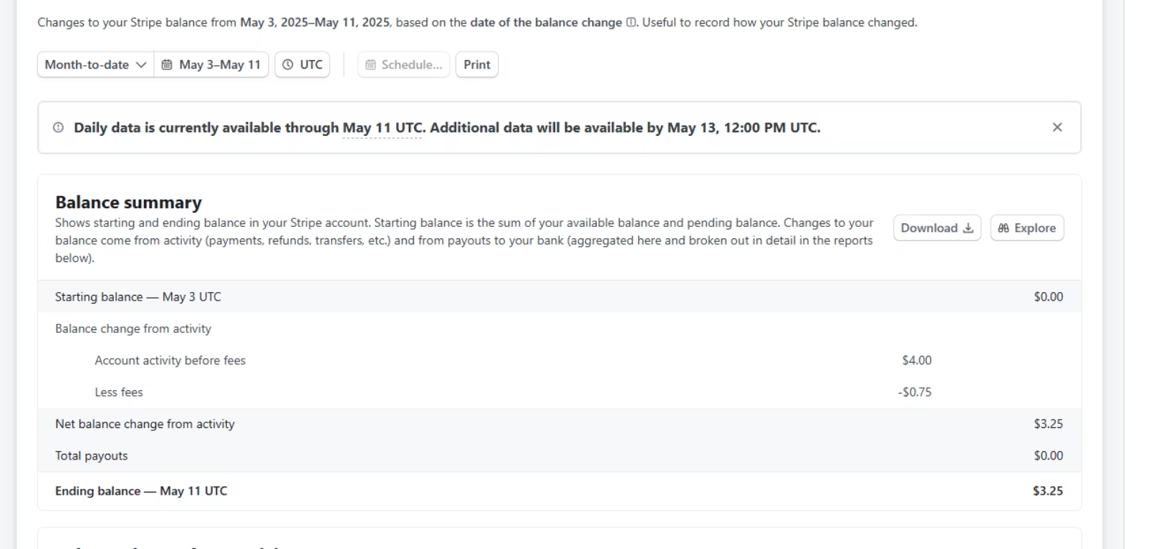
Revenue Metrics
Our platform generates revenue through streams tracked via Stripe integration in developer mode.
Notes:
11

Slide 9



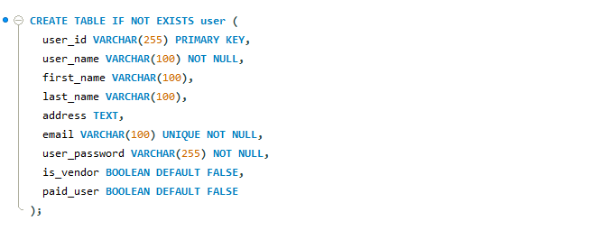
06 Stored Procedures Demonstration
Create User Table
Insert User Dummy Data
Insert Marketplace Dummy Data
Initialize database with proper schemas
Populate tables with test user data to validate functionality and performance
Populate tables with test marketplace test data from node.js script + .csv
Notes:
12

Slide 10
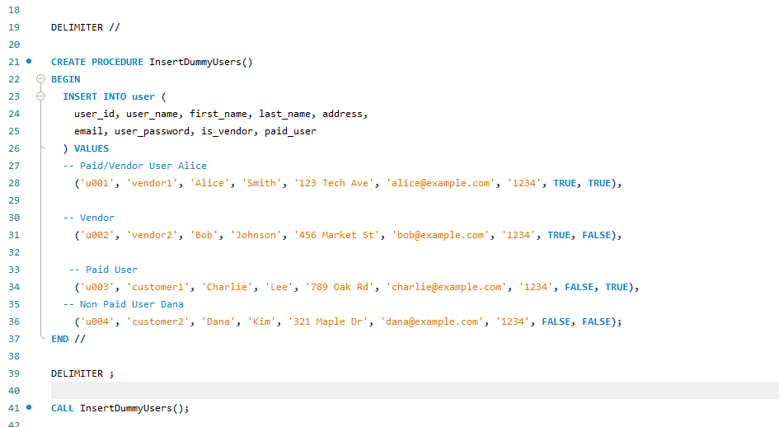
06 Stored Procedures Demonstration
Create User Table
Insert User Dummy Data
Insert Marketplace Dummy Data
Initialize database with proper schemas
Populate tables with test user data to validate functionality and performance
Populate tables with test marketplace test data from node.js script + .csv
Notes:
12

Slide 11
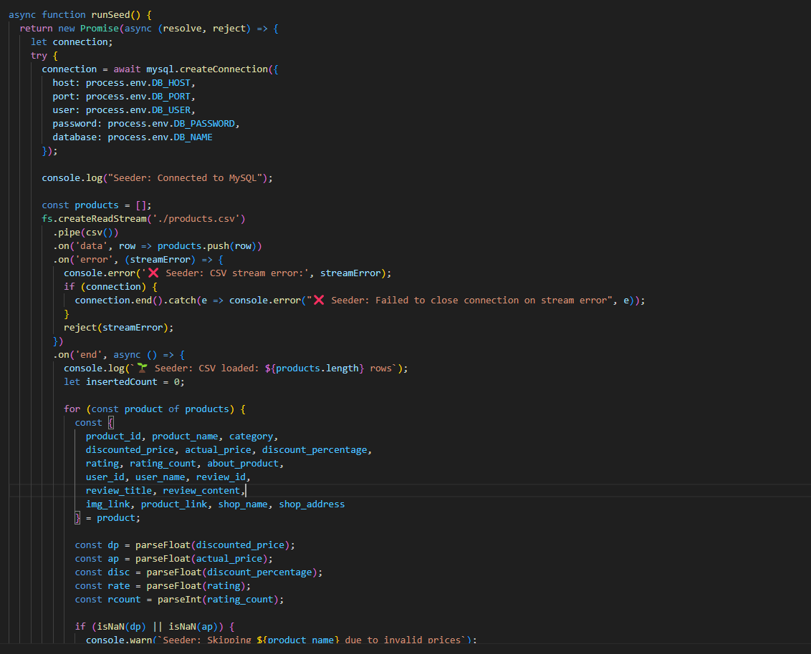
06 Stored Procedures Demonstration
Create User Table
Insert User Dummy Data
Insert Marketplace Dummy Data
Initialize database with proper schemas
Populate tables with test user data to validate functionality and performance
Populate tables with test marketplace test data from node.js script + .csv
Notes:
12

Slide 12
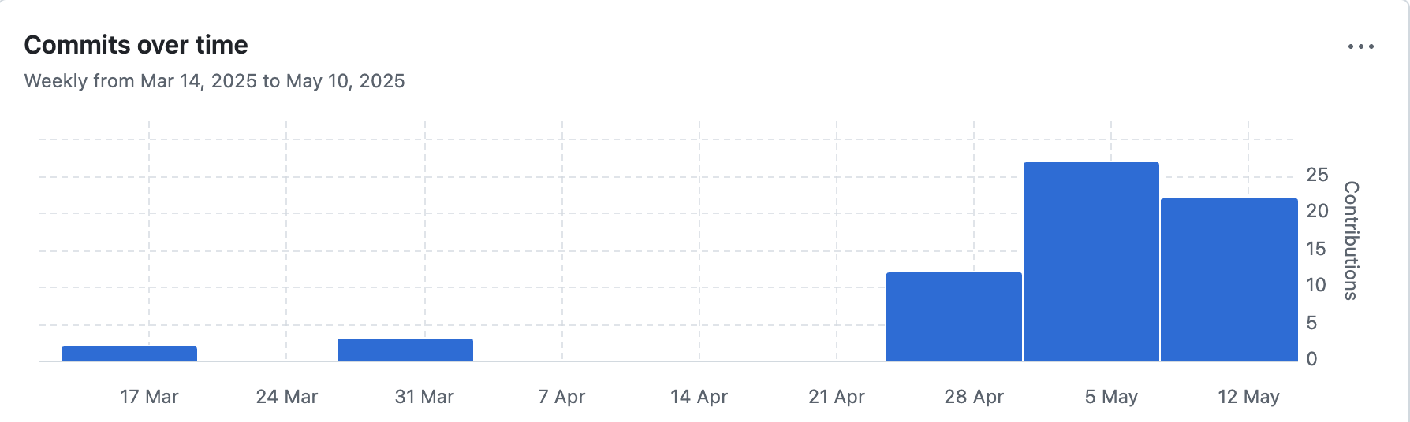
07 Team Work
GitHub Workflow
Roles
Our team implemented an efficient Git branching strategy with feature branches and pull request reviews to maintain code quality.
Backend
Olufemi Adeonigbagbe, Ahmed Hamouda, Brandon Bedoya
Commit History
Frontend
Cai Rong Li, Minning Liu, Yulin Ding
Collaboration Tools
GitHub Projects
https://github.com/datasheng/csc33600-repo-7
Communication
Discord
Notes:
13

Slide 13
08 Extra Credits
AI Chatbot Assistant
Containerized App via Docker
User-Friendly UI
Notes:
14

Slide 14
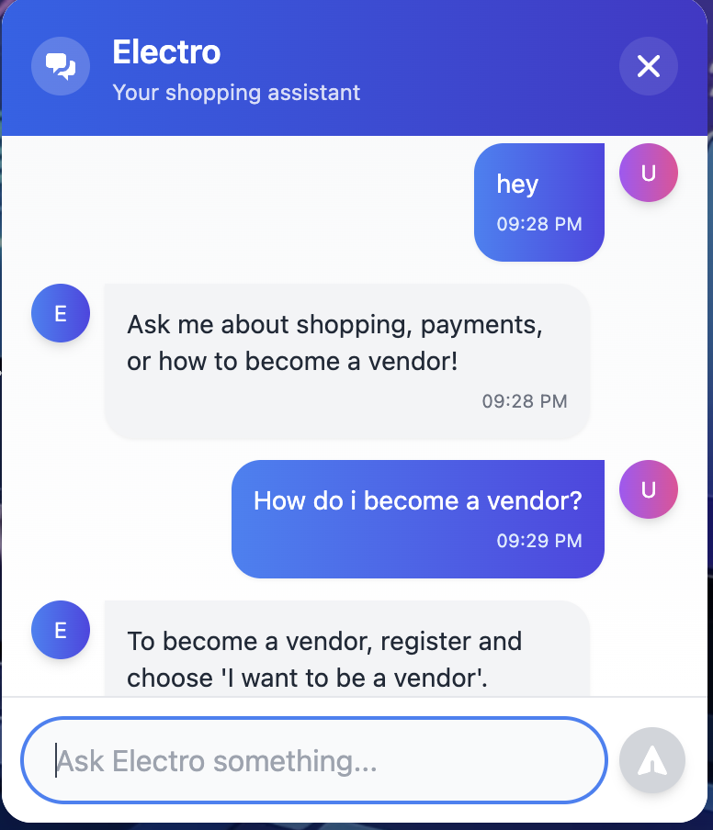
AI Chatbot Assistant
Our intelligent virtual assistant provides users with personalized suggestions and assistance.
Notes:
15

Slide 15
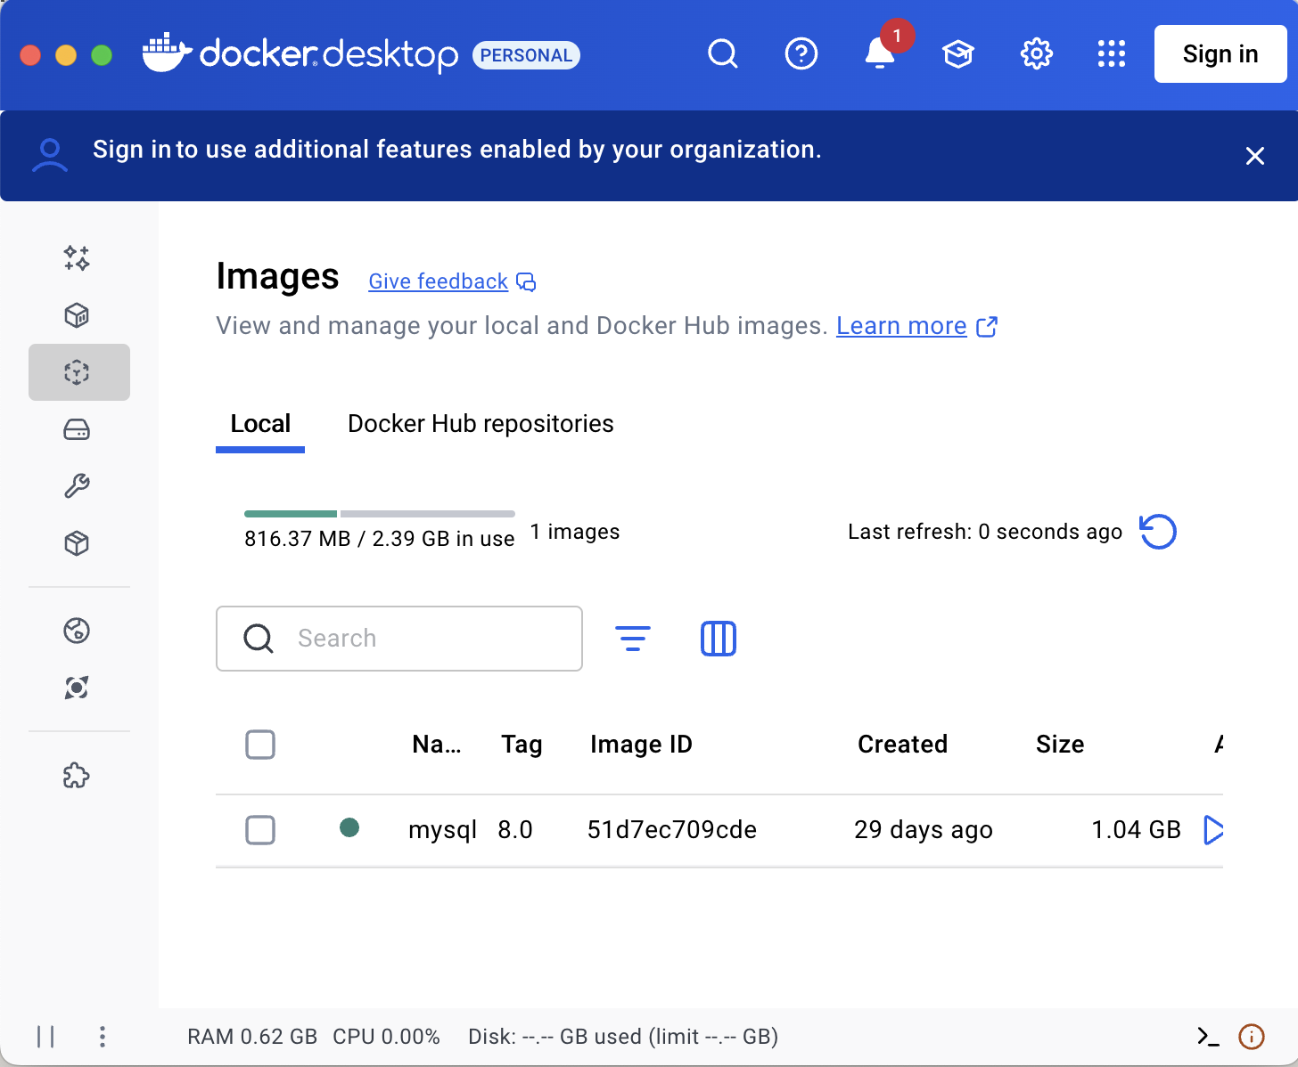
Dockerized Application Architecture
Docker containerization with distributed deployment.
Add docker logs
Add front/end backend logs as an example of deployment.
Frontend
Backend
Deployed on Render
Deployed on Render
SQL Database
Stored on AWS
Notes:
16

Slide 16
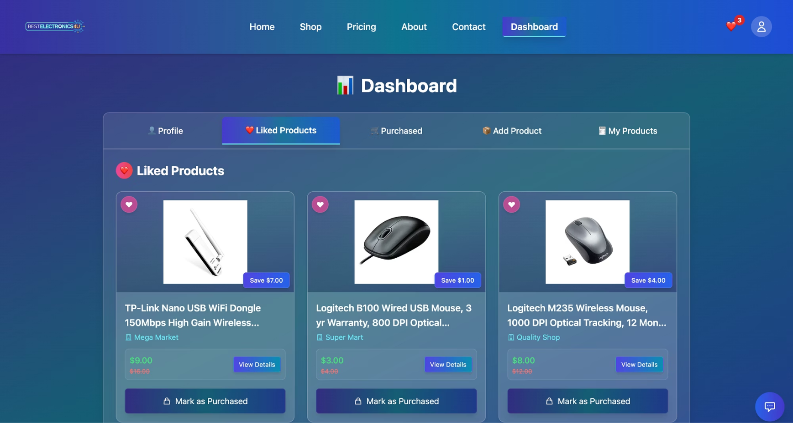
User-Friendly UI
Notes:
17

Slide 17
Thank You for Your Listening
Q&A Session
Live Site: https://bestelectronics4u-frontend.onrender.com/
Notes:
18

